Slide 1
Rising Senior Workshop April 15, 2025

Slide 2
The purpose of this workshop is to improve communication and preparation. The Class of 2026 will be knowledgeable about the senior year process in advance.

Slide 3
Principal: Mr. Stewart Class of 2026 AP: Dr. Thompson

Slide 4
Amy Garrey (Lead Counselor; Ti-Z)
Nicola Henry (A-Dj)
Angela Ball (Dk-Ko)
Chastity Rubin (Kr-O)
LaDale Webster (P-Th)

Slide 5
College and Career Readiness Advisor
Dr. Kasha Williams
Info now, Questions Later

Slide 6
What Do You Want to Do?
College?
Military?
Trade School?
Workforce?
Still thinking about it?
There Is A Place For Everyone!

Slide 7
CCMR Connection
CTE CERTIFICATION (graduation)
SAT, ACT (ongoing)
AP EXAM (July), DUAL CREDIT (June)
IEP-WORKFORCE READINESS (graduation)
ON RAMPS (June-except USH, E4)
TSI (MAY 15th, JUNE 10th)

Slide 8
Military Service
Military academies are highly competitive and prepare students for service in the officer corps of the Army, Navy or Air Force
The ROTC is a college-based program for training commissioned officers of the United States armed forces.
The ROTC scholarship is viable at many different colleges and includes full tuition benefits
Your campus CCRA can assist with:
Connecting you with a local recruiter
Registration for a local ASVAB administration

Slide 9
Fall Industry Lineup
CDL / Trucking
Real Estate License
Cosmetology / Barber
Welding, Refrigeration, HVAC
Car Dealer
Texas Workforce Commission

Slide 10
College Enrollment Benchmarks
Some colleges are test optional. BUT…you still need TSI for enrollment placement.
Acceptance is not enrollment
Students on free/reduced lunch are eligible for a fee waiver

Slide 11
Applying for the FAFSA
No matter your route…ALL SENIORS will complete a FAFSA or Opt-out Form as a graduation requirement
Need-based financial aid from the federal government (grants, work-study, loans)
Most institutional scholarships require a FAFSA
Both open on October 1
This is NOT scholarships (YOUR part-time job)

Slide 12
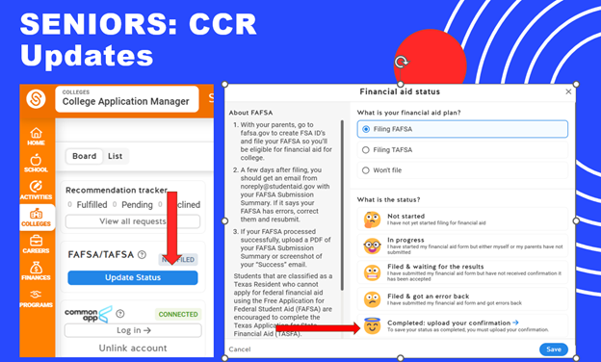
FAFSA UPLOAD

Slide 13
Giveaway!!

Slide 14
COMMUNICATION
DHS Website: CCR (CHECK FAQs!)
Instagram @dullesccr scholarships, jobs, and reminders
Schoology Course – all resources
Trust the System! Don’t “double-check” on a problem that does not exist. Production > Perfection.

Slide 15
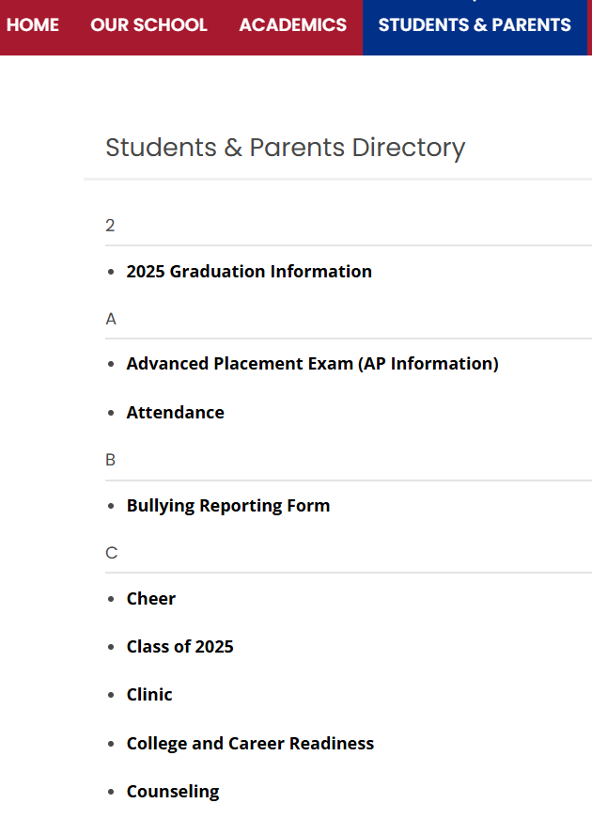
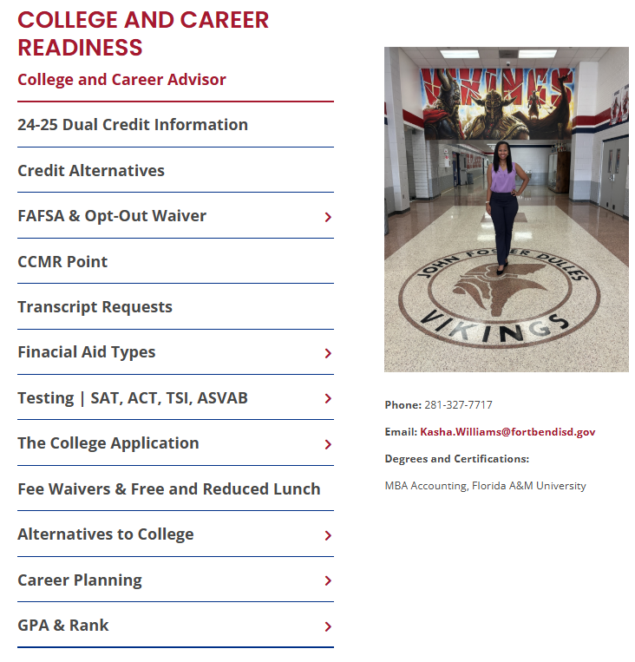

Slide 16
SchooLinks or it never happened!
Senior Rollover approximately 7/15
Practice this summer!

Slide 17
College Application Platforms (Opens 8/1)
ApplyTexas
www.applytexas.org
Common App
www.commonapp.org
Out-of-Network
Many schools have their own application process
Regardless of which platform you choose, please create your account with your personal email address (and for JOBS)
USE A LAPTOP, NOT YOUR PHONE.

Slide 18
Timeline

Slide 19
June-August 2025
Q1
Make your list based on your goals
Request fee waivers
Take your ACT and/or SAT
Write your college essays
Update your resume
Tour your schools
Consider teachers for recommendation letters
Create your account on your application platform of choice

Slide 20
September-October 2025
Q2
Reapply for free/reduced lunch if you qualify
Continue to work on your applications on your platform of choice
Attend the district college fair on October 1 (Travis HS) or 8 (Marshall HS)
Complete your FAFSA/TASFA (October) and upload proof in SchooLinks to satisfy graduation requirement
Request teacher/counselor letters of recommendation in SchooLinks
Take the ASVAB if you are planning on joining the military
Request initial transcripts in SchooLinks

Slide 21
November 2025-February 2026
Q3
Start applying for school-based scholarships
Submit applications to colleges with November-February deadlines
Ensure mid-year transcripts are sent to your schools
Bookmark all portals and save the passwords to them

Slide 22
March-May 2026
Q4
Apply for housing
Take the TSI if necessary
Submit all scholarships earned into SchooLinks
Make final transcript request in SchooLinks
Register for New Student Orientation at your university
Schedule your meningitis shot
Request OnRamps or Dual Credit transcripts from UT or HCC
Graduate and celebrate!

Slide 23
Cap & Gown
Senior Pic
Yearbook
HoCo
Senior Happenings

Slide 24
Breakout Session

Slide 25
Schoology & Attendance
COURSE Code
6VSG-SG7K-V3FBN

Slide 26
SchooLinks Views
View GPA & Rank
Test Scores
CCMR Point Status

Slide 27
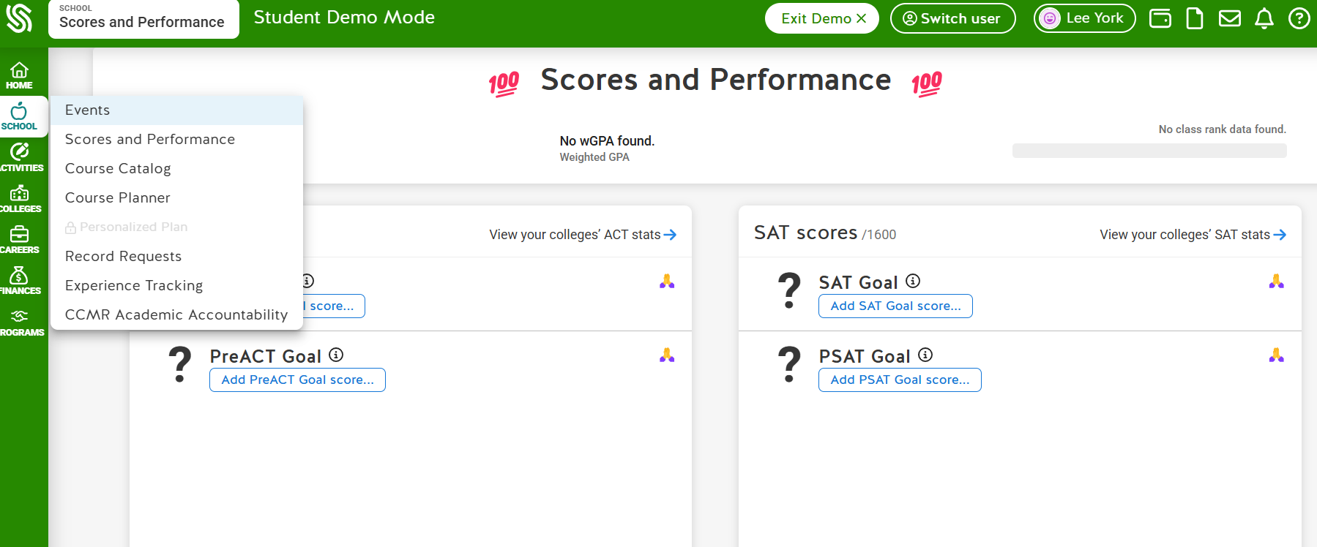

Slide 28
Skyward Portfolio

Slide 29
Ranking & Transcripts
FBISD provides rank separate from the transcript. The letter is in Skyward.
Juniors will be ranked in June 2025 and again in September 2025
A transcript will run in September that includes all coursework up to and including Summer 2025
Students will have the ability in SchooLinks to select if they want their rank shared with colleges
Please note that once a student has selected this option, they cannot change it

Slide 30
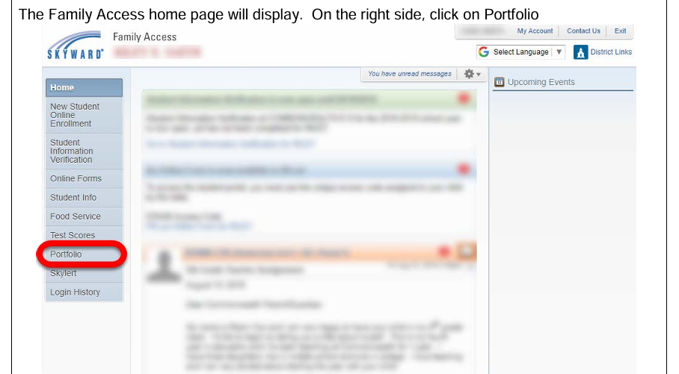

Slide 31
Etiquette
Email – Full Name and a Subject
Signatures - First and Last name, pen, cursive)
Professional, non-school email address
Make requests 2 weeks in advance w/resume and due date
Sign in and out of counseling suite

Slide 32
Applications

Slide 33
How To Make A College List
Make a list of 10 schools
Target Schools, Reach Schools, Safety/Likely Schools
In SchooLinks, click on Colleges/School Search
Adjust the filters to meet your needs, based on School Type, Campus Location, Acceptance Rates and more
Click the heart to add any school to your list of FAVORITES
Do NOT add them to APPLICATIONS – it generates a transcript request

Slide 34
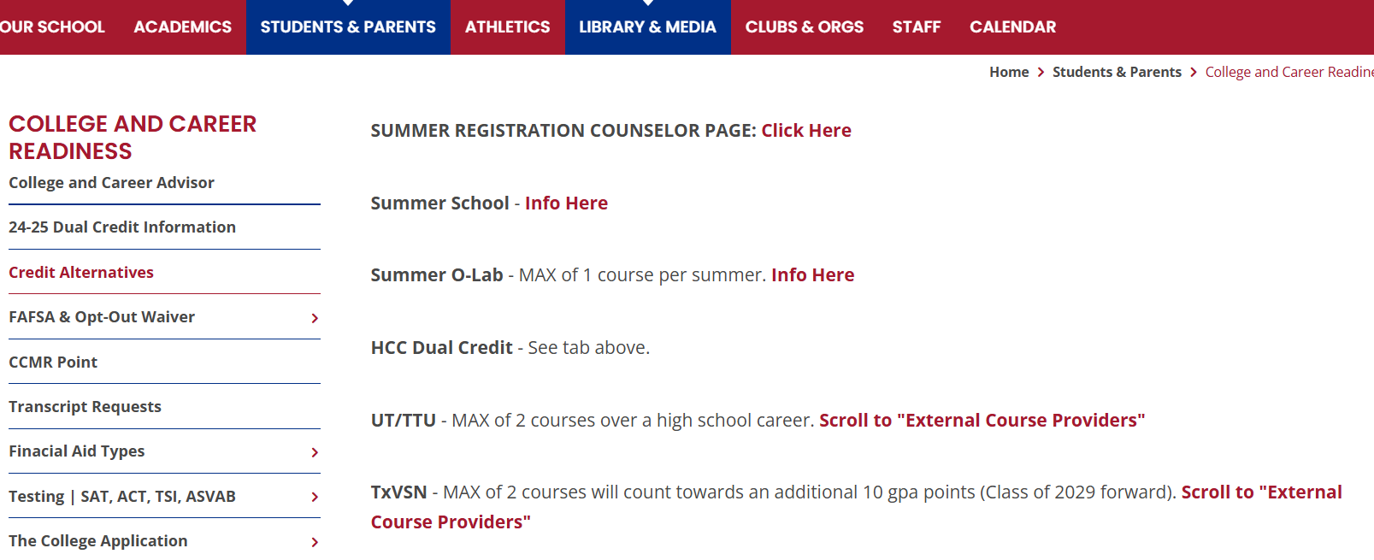
Credit Alternatives

Slide 35
Make-Up Hours Note: 18 Credits = Senior! Finish Strong!

Slide 36
SchooLinks To-Do

Slide 37
Finding Scholarships in SchooLinks
Browse to Finances/Scholarship Matching
Use the filters at the top to locate scholarships that match your needs and pursuits
Mark your favorites using the heart symbol. You can also apply directly from SchooLinks.
These scholarships are posted by your campus, your district and by SchooLinks.

Slide 39
THANK YOU Class of 2026!

